Slide 1
Entrant Essentials 1: Arriving to the University of St Andrews
Disability Webpage​
disability@st-andrews.ac.uk​
01334462020
Notes:
Hi, welcome and thank you for joining us for our Entrant Essentials 1 webinar. We are holding these webinars to share some essential information to help you prepare for commencing your studies at the University of St Andrews. Today’s webinar will be focusing on supports available, accommodation and orientation week.
A recording of this presentation will be available after todays live session. You will be able to access it by using the same link as you have used today. As we go through the session you will note that there are some hyperlinks within the slides – you will be able to click on these to access additional information and go through them at your ease. These links will provide even more detail and information.
We will also place a link to all the sessions in this series on our University Disability webpage.
There will be an opportunity for live viewers to ask general questions at the end of the presentation. Any individual or personal questions should be directed to the disability@st-andrews.ac.uk email address so that we can address these for you confidentiality.
To ask questions you can type into the window pane on the right hand side of the screen. If we feel that your question would be better answered in person then it will not be published and we will either answer this privately or respond with a follow up email in due course.

Slide 2
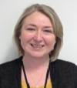
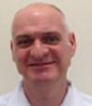
Student Services Disability Team
Director of Student Services –
Dr Lara Meischke​
Assistant Director (Accessibility & Inclusion) – Dr Fiona Whelan​
Disability Advisers – Sheila Baillie, John Petrie, Michelle Petrie and Kate Leavy​
Notes:
Speaking today will be myself, hi I am Michelle, and also my colleague Kate Leavy.
We are two of the team of four Disability Advisers based here in St Andrews, our fellow Disability Advisers are called Sheila and John and our team is managed by Dr Fiona Whelan.
Our Director of Student services is Dr Lara Meischke – who oversees the running of all of the student services teams.

Slide 3
Pre-arrival information for 2021/22
Pre-arrival checklist 21/22
Coronavirus information pages
Scottish Government Guidelines
Notes:
We understand that you may have specific questions regarding coronavirus and would therefore highly recommend viewing the University's dedicated pre-arrival and coronavirus information pages.
All students must complete the pre-arrival checklist for 21/22 which includes allows you enter detail on your study plans, your study location, if you need to isolate or quarantine on arrival, request isolation accommodation, request managed quarantine, book travel and arrival slots and update your vaccination status. Students are asked to provide as much information as possible and also update their details if their circumstances change.
The University will offer dual mode teaching in 2021-2022. This will allow students who are unable to attend in-person classes to start their studies through a blend of pre-recorded content and live, interactive online sessions. The University hopes that you will be able to travel to St Andrews and begin in-person learning as soon as it is possible to do so. For some, this may mean starting your studies online and then changing to in-person learning.
If you plan to study online away from St Andrews all semester 1, you only need to complete task 1 in the checklist: ‘Update your study plans and your study location details’. Online study is not available to students studying BSc Hons Medicine or the Graduate Entry to Medicine (ScotGEM) programme.
Students do not need to request permission to study online, but are required to keep their study location details up to date. It is especially important that the University is informed if any student intends to switch between online study and in-person learning, or vice versa. If your circumstances change before the start of semester, please update your study location details through MySaint.
The University coronavirus pages include a host of information, including detail on how to access covid testing, the University covid code, latest covid numbers, vaccinations, wellbeing resources, and teaching in 21/22. There is also a section on frequently asked questions that may be helpful to read through.
The changing nature of the COVID -19 situation means that the central premise of all these guides is that you should check the most recent Scottish Government guidelines before travel and that you must understand the latest quarantine requirements.
Both webpages have been hyperlinked in this presentation for you but can also be found by accessing the University’s main landing page st-andrews.ac.uk and then clicking the link Pre-arrival information for 2021-22.

Slide 4
Making Contact with the Disability Team
Range of services offered
Information and documentation required
Disability Students allowance
Our webpage can be found here: https://www.st-andrews.ac.uk/students/advice/disabilities/
Contact details:
01334462020
disability@st-andrews.ac.uk
Notes:
If you haven’t done so already, we advise that you get in touch with a Disability Adviser as soon as possible, ideally before your course commences, so that we can discuss your support requirements and start getting arrangements in place.
The Disability Team offers a wide range of services including support for students to access their course of study, creating support plans for teaching and exam arrangements, liaising with the accommodation team, timetabling team, liaising with academic staff in schools and providing advice on and assistance with applications for Disabled Student’s Allowance. This is government funding that is available for UK students only, if eligible.
Okay, so step one and to let us know that you have a disability we would ask that you enter your information in one of the following key touch points: when applying by noting in your UCAS application, when completing matriculation, by updating your MySaint account (which is open to do this for the first week) or by simply getting in touch via the contact details on the slide. Once you have declared a disability with us you will then receive information throughout the semester from us. If you are not able to update your disability status information, please get in touch with us and we can assist you with this.
Then step two is to formally register with the Disability Team. To do this, we require relevant documentation relating to your condition so that we can review and advise appropriate support for you. This could be in the form of a letter from a GP, consultant or educational psychologist. You can send us this information in advance of arriving in St Andrews.
If you have queries on your ability to provide supporting evidence again we would encourage you to get in touch to discuss this with us.
Disability Students Allowance is specific government funding that is available to UK students and is specifically to cover any extra study-related costs due to a disability. This is a non-repayable allowance and is not means tested.
If you have already applied and completed a Disabled Students’ Allowance Needs Assessment, then please send us a copy of your report and DSA award letter so that we can help arrange the recommended support before you arrive.
There is lots of information on our webpages but if you have a specific question, require additional information or would like to arrange an online appointment to speak with a Disability Adviser, you can call us on 01334 462720 or email disability@st-andrews.ac.uk
To ensure your support plan is put in place in good time, please make sure you get in touch with us.

Slide 5
What to expect when you meet with us
Introductions
Explanation – what the disability team do
Documentation
Disability support plan
Accessibility
Disabled Student's Allowance, if eligible
Opportunity to ask questions
Follow up details
Notes:
If you are still to meet with us, we thought it would be helpful to share some detail on what to expect during an appointment with a Disability Adviser. Currently all appointments with Disability Advisers are being completed online via the platform Microsoft Teams as we are working remotely, in line with Scottish Government guidance. You can speak to us via email, telephone or video appointments.
Or online appointments start with an opportunity for the attendee and the Disability Adviser to introduce themselves. The Adviser will ask the attendee if they know what the Disability Team does and will share detail in line with the attendee's response. The body of the meeting will include discussions about documentation, how to source this if required, if applicable the attendee's previous support at school, developing their University disability support plan, any accessibility requirements and if eligible how to apply for Disabled Student Allowance. The conversation is led by the student, their disability and experiences.
Attendees are given an opportunity throughout the meeting to ask questions, and will be advised how to ask questions following the appointment too. The Disability Adviser will clarify any follow up details, including any subsequent appointments and contact details.
If would like to arrange an online appointment to speak with a Disability Adviser, you can call us on 01334 462720 or email disability@st-andrews.ac.uk

Slide 6
Student Services
Buildings at Eden Court and the The ASC on North Street
Can help with academic and non–academic questions
Services:
Disability Advice and Support
Money Advice
Wellbeing Support
Counselling
Mental Health Support
International Advice
Wardennial Service
Health Hub
Notes:
The Disability Team are part of a larger team here in Student Services. We have buildings at Eden Court on the Scores and at the ASC on North Street. Sometimes Advisers work in other locations around campus to offer a variety of appointment options. However, please note that at present, due to COVID-19 student services are working remotely. You can speak to us via email, telephone or video appointments.
Student Services help with a whole host of matters, including academic and non-academic questions. Services offered to students include money advice, wellbeing support, counselling, mental health support, international advice, the Wardennial service and we also have our Health Hub. We can refer you to services as appropriate.
The University's Student Health Hub, is an office located in the local community hospital. It is currently being virtually staffed by our colleagues Mandy and Karen. For any queries regarding healthcare this is a good place to start. They can help you access health advice by assisting with registering with the local GP’s. Make sure to also check out the Student Health app! This is a great resource to help with self-diagnosis and management of some symptoms. For more information please be sure to check out the advise and support webpages.
There are also other people that can help you such as the Chaplaincy, who sees people of all or no faiths; disability coordinators in academic schools and also school office staff. Please check out your schools webpage for information on who to contact in your school.

Slide 7
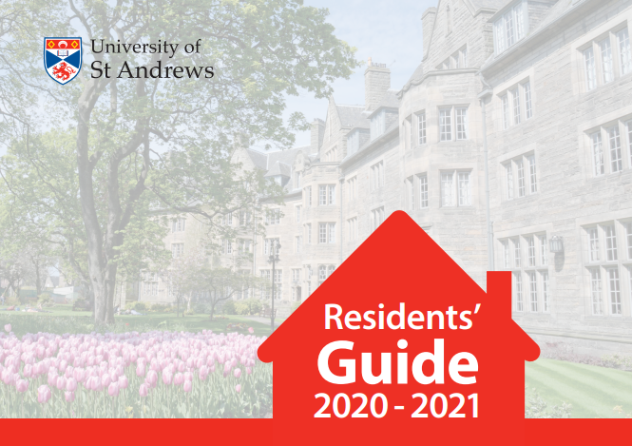
Planning and arrival
Student Accommodation
Resident's Guide 21/22
What can I bring
What can I pack
Information on arrival to your hall
Isolation and quarantine information
Notes:
An exciting and important part of your move to St Andrews will be settling into your accommodation. Many of you may have an offer of residence at this point or already accepted your offer.
Student accommodation have prepared a very useful Residents’ Guide for students who will be living in Halls of Residence. It includes practical information that you need to know from arrival to facilities to cleaning and safety, and many other topics. It also contains a map of where all the residences are located in St Andrews. Make sure you check this out.
The University website has advise on what to pack and items that are not permitted. You can also find additional useful information about what to pack in the orientation webpage.
Collecting your keys – students must book a date and time slot (you can do this via the pre arrival checklist) once an offer is accepted. There are limited numbers for each date so please ensure you complete this as soon as possible.
Please note that only one person will be permitted to accompany you whilst moving in. We apologies for the restriction but we are unable at this time to accommodate any more people.
Information on isolation and quarantine in student accommodation can be found in the University coronavirus FAQs.
Please use the hyperlinks provided to take you to the information signposted.

Slide 8
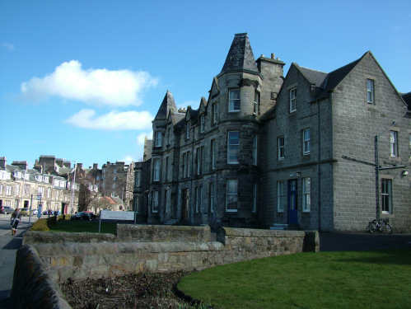
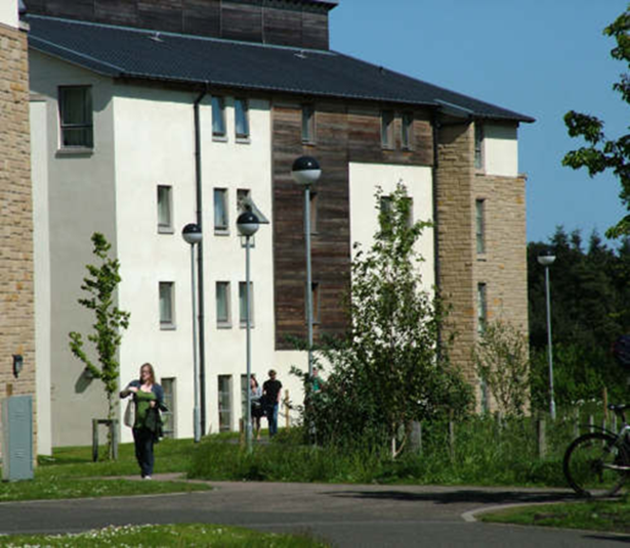
Accommodation Essentials
Residence Management Team
Housekeeping and Porter Team
Wardennial Team
Chef Manager and Catering Team
Senior Student and Hall Committee
Communal areas
Shared living basics
The working of a hall
Notes:
Each residence has a Residence Management Team looks after the daily running of the hall including overseeing the condition of the general hall environment, housekeeping services, general maintenance and repairs, health and safety and maintaining discipline. Please see the specific hall information on the University accommodation webpages for details of who they are, and how to contact them.
Within each residence, there are Housekeeping and Porter Teams. They work closely with the Residence Management Team and are responsible for helping to maintain the cleanliness and carrying out any repairs within the halls. Although there are cleaners, you are expected to keep your room clean. If you have any issues relating to the fixtures and fittings of your room or any of the communal areas, contact the Residence Manager, they are available from Monday-Friday.
The Wardennial team is made up of a Warden and Assistant Wardens. The Wardennial team provides out-of-hours contact and support, as well as links to daytime services to ensure that help is available at all hours of the day. They are a first point of call if a health crisis occurs or if you are distress or are experiencing difficulties. Wardennial staff are always keen to support students, however there are limitations to their remit. The support they offer is pastoral rather than medical and is designed to be ‘light-touch’ promoting autonomy and independence. It is expected that students in halls are capable of independent living in a large shared environment, with appropriate support in place, where applicable.
Wardens and assistant wardens undergo regular training and are qualified to provide emergency first aid. They are supported by the Student Services Response Team who work evenings, nights and weekends.
The wardennial team is on duty between 7pm and 8am every weekday (Monday to Friday) and between 2pm and 8am at weekends (Saturday and Sunday). They also provide drop-in sessions in each hall. The times for drop-in sessions and contact details for each warden will be given to you in your residence information pack when you arrive at your hall.
Wardens and Assistant Wardens have additional roles within the University either as fulltime postgraduate students or members of staff with first-hand knowledge of both academic and non-academic aspects of life in St Andrews.
Catered halls also have a Chef Manager and catering team. The Catering Team in your hall is responsible for preparing and serving meals. If you have any specific food allergies or dietary requirements, please contact the Catering Team as soon as you are offered a place in a catered hall so that the appropriate arrangements can be made for you. The Chef Manager’s contact details can be found on the Hall specific webpage. Meals in residences are at set times so please check the specific hall information on the Accommodation webpages. If you are unable to return to your hall for lunch, you can request a packed lunch be provided instead and can be ordered up to the morning it is required. Please speak to or email your Chef Manager for more information. Sample menus for catered accommodation can be found on university accommodation webpages. If you have any issues related to catering in your residence, please bring this to the attention of the Chef Manager.
Senior Student and Hall Committee In each residence there is a Senior Student, who is responsible for working with the Warden and the student residents to develop the community spirit within the residence. There is also an elected Hall Committee, which meets to discuss matters of student interest and represent the residents’ views to the Warden, Residence Management Team and the wider University. Your residence fee includes a Hall Committee subscription which is used to put on events and purchase items for the residence, as well as pay for any unattributed damages throughout the year.
Each hall has a range of communal areas such as study rooms, tv rooms or games rooms.
There are also laundry facilities. Your hall guide will have information and guidelines on how to use facilities.
The Wardens can help resolve difficulties in your hall such as issues in social areas or problems using shared facilities.
When living in shared living, it is important to follow these key tips: If you use the kitchens you must clean up after yourself.
Students are not allowed to take electrical kitchen equipment such as kettles and toasters into their rooms.
Do please check accommodation information for permissible items.
You cannot use other students pots, pans and utensils without asking and getting permission to do so.
And you cannot use other students’ food unless they have offered to share with you.
A series of social events will be all arranged by the hall committee and wardennial team in each hall.
These events are not compulsory and Wardens are aware that some students may find these situations uncomfortable or simply of no benefit to them.
If you are interested in attending an event within your hall the Wardennial Team are happy to assist and can explain what exactly the event will be, and how long it is expected to last. There may be a social media page for your particular hall that you may want to follow for more information.

Slide 9
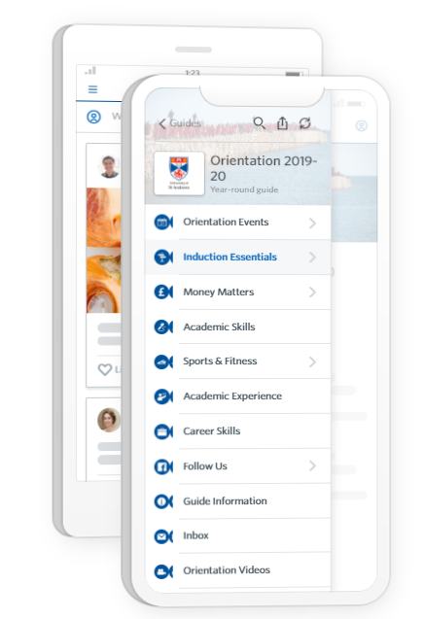
Orientation Essentials
What is orientation?
Orientation app and guide 2021
Who can help me?
Centre for Educational Enhancement and development (CEED)
Notes:
Orientation week is a week that is dedicated to helping you settle into University, find your feet and become a registered matriculated student of the University. You may also hear orientation week referred to as "freshers week". Starting University is a big change and it is very common to have lots of questions as you navigate and familiarise yourself with your new academic setting. We want to support this transition.
The Universities orientation webpage and dedicated module and app are essential reading for any new student. We would advise you to download the app and take some time to browse through the content.
An important thing to remember is that although some events are compulsory in orientation week some are not, so remember you don’t have to do it all! And during orientation week there will be many people who will be on hand to assist you.
Student Services staff will be able to help you with any queries you have. We also have mentoring schemes that match first years with older students to help with your transition and answer questions on a variety of subjects.
Peer mentoring schemes can offer support transitioning into or through University. These are coordinated by a our colleagues in CEED (Centre for Educational Enhancement and development). For more information regarding this or contact details please click on the link.

Slide 10
Matriculation
What is matriculation?
Matriculation process
Online Matriculation
Advising
Notes:
Matriculation is the process of officially registering as a student with the University and is compulsory for all students.
Matriculation will be completed online, this will include ID and document checks. You will need your passport for identity verification. Students from the UK will need their UK birth certificate if they do not have a passport. Please note that in-person documents checks will still be required for some students for visa purposes and will be completed in accordance to government guidelines of physical distancing and hygiene measures.
The process is made up of two parts – online matriculation and advising.
The online part of matriculation is completed via the student portal, My Saint. All new students will be emailed by the University with details on how to access My Saint.
Online matriculation will include various items, for example reading essential information, paying tuition and accommodation fees, updating personal details (it is this section that we would advise you make sure your disability status is up to date) and completion of online training in good academic practice (also commonly referred to as TGAP). This gives you information and training on the values expected of you as a member of our academic community.
International students must bring their visa or biometric card for UK Visas and Immigration check. You should collect your Biometric Residence Permit card as soon as possible once you arrive in St Andrews. To collect your card you will need your passport and the letter you will have received stating your BRP has arrived. You will receive information on the process to collect these. So please keep an eye out for that in your inbox!
Each undergraduate student in the Faculties of Arts, Divinity and Science is assigned an Adviser of studies, who is a member of academic staff in the same Faculty as the student. There is a compulsory meeting at the start of the academic year to discuss and approve module choices, and the Adviser of studies is available for consultation at other times.
Advising is the process of agreeing, and being enrolled in, specific modules. Advising will take place online via Microsoft Teams. Until your module choices are approved by your Adviser of Studies at this meeting, and validated in the academic advising system, you are not officially enrolled in those modules. Advising meetings for undergraduate and taught postgraduate students studying at the University in September 2021 will take place Monday 30 August to Wednesday 8 September 2021. Further details will be sent to you on this.
In order to get the most from your meeting with your Adviser of Studies, it is important that you have done some initial research and thinking about your module choices prior to your meeting, and submitted provisional choices during the pre-advising process. Further details of degree programmes and modules, including compulsory modules, can be found by searching or browsing the online course catalogue on the University webpage. Additional information is also available on school web pages.

Slide 11
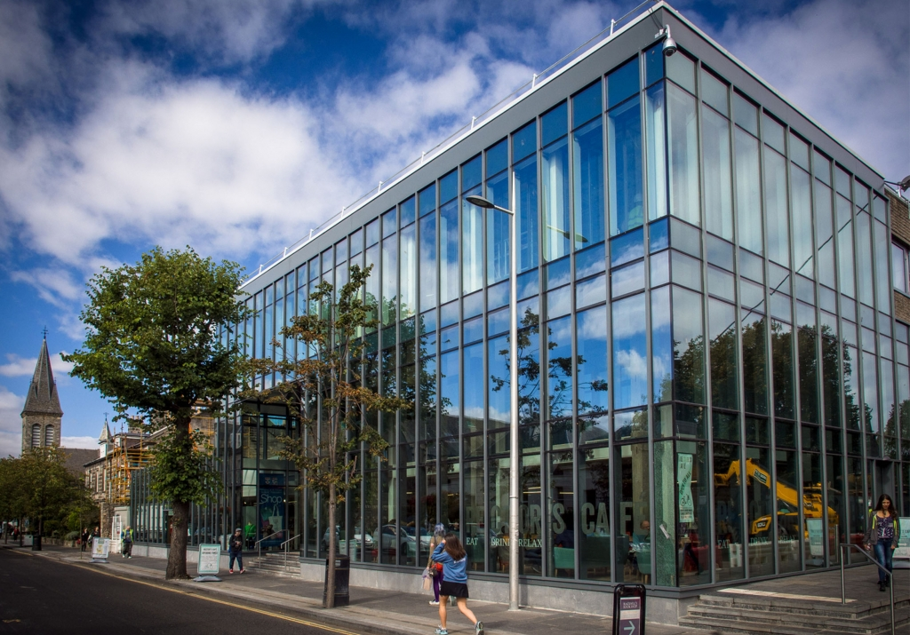
Student Union, Freshers’ Fayre and Events
Student Union
Freshers’ Fayre
Freshers week events
Academic families
Getting around St Andrews
Wellbeing map
Notes:
The Students Union can also be known as the Students’ Association. It is a hub of student activity in St Andrews.
All students of the University are automatically members.
The Association (or Union, as it is better known)– it covers all areas of student life including events, student representation, student support and extra-curricular activities – it is more that just a bar!
At times we may liaise with student representatives in the Union called SABBs (sabbatical officers) to ask them to circulate information in their regular updates to the student body. However, and primarily they are in post to support you, whether this is by collating feedback from class representatives from within your school or representing your views to the University. They are there to assist you by trying to make your student experience as strong as it can be.
The Students Union will run a number of events during orientation week which is also known as freshers week. Details can be found on the Students Union website or within the app. Freshers is getting a new look this year. For the first ever year, the heart of Freshers is moving to North Haugh on our brand new, custom built site, to give students the best experience possible.
This year Freshers’ and Sports Fayre will be combined and held on Monday 6th (2pm-5pm) & Tuesday 7th (11am-5pm) at the Sports Centr. All societies, subcommittees, sports groups and vendors will be outdoors around the University Sports Center. There will be an Accessibility Period for those with access requirements which will also have more strict COVID requirements including social distancing on Monday 6th: 2:00 – 2:30pm
If you decide not to get involved or later decide that you no longer want to take part in something then that is OK too.
Don’t worry if you find that participating in some events overwhelming during orientation week. There is so much information to take in. You can always join at a later date.
Academic families form a big part of the freshers experience and part of your time at St Andrews. This is a tradition where older students (usually third years and beyond) adopt first year students as their children. Its a great chance to meet new people and start to form connections at uni. Throughout Freshers you'll get many chances to find academic parents at different events, in your hall of residence, through societies and clubs or through the Union's dedicated Academic Family Finding events.
St Andrews is a small town but for help in finding your way around please click the hyperlink for a map. The wellbeing map is a great resource if you are looking for inspiration!

Slide 12
Mentoring and Peer Support
Transition support
Mentoring schemes
Peer support
Notes:
Starting university is a big change academically and socially. It is very common to have questions as you become independent, navigate new relationships and familiarise yourself with new academic practices and standards.
The University offers a variety of support to help you make this transition, whether in the form of informal advice from your peers, joining a mentoring scheme, or seeking help through a School or Student Services.
There are a number of mentoring and peer support schemes available.
Mentoring schemes match first years with older students within their academic Schools or societies, allowing the student to benefit from the perspective of someone who has recently been in their position.
You can find out more about mentoring schemes for undergraduates and postgraduate by clicking the hyperlink
Peer Support is a one-to-one meet-up service open to any student looking for a little extra company and friendship during their time at St Andrews.
Please speak to a Disability Adviser if you would like more information or help to sign up for mentoring or peer support.

Slide 13
Communication with parents
Notes:
The University views you as an independent adult. However for some students we acknowledge that your parents may have good information and advice that may benefit your settling in and your progression at university. Therefore we may wish to speak to them if we feel you need support in either the academic environment or within halls or private accommodation.
If you are willing for us to speak with your parents, we will require you to sign a consent form and can arrange this at your first Disability Advice meeting as we currently follow an opt in model.

Slide 14
Some things to consider before you arrive
Have you been in touch with a Disability Adviser to discuss your support requirements?
If you haven’t yet, contact the Disability Team to discuss your support requirements before your course begins.
Have you sent information about your diagnosis?
Have you applied for Disabled Students’ Allowance, if applicable (UK students only)?
What would you like to know more about? Let us know so that we can give you information, advice and reassurance.
Read the Universities guidance on “before you depart” including what to pack, maps and lots of other useful information.
Notes:
Have you been in touch with a Disability Adviser to discuss your support requirements?
If you haven’t yet, contact the Disability Team to discuss your support requirements before your course begins.
Have you sent information about your diagnosis?
Have you applied for Disabled Students’ Allowance, if applicable (UK students only)?
What would you like to know more about? Let us know so that we can give you information, advice and reassurance.
Read the Universities guidance on “before you depart” including what to pack, maps and lots of other useful information.

Slide 15
Any questions?

Slide 16
Thank you for joining us!
Please join for the next webinar in the series, Entrant Essentials 2: What you need to know about Teaching and Learning at St Andrews on Monday 23rd at 3PM BST
Notes:
Thank you for sticking with us through this bombardment of information!

